Slide 1
Topic Modeling
Dr. Manika Lamba

Slide 2
About Me

Slide 3

Personal Website
PhD, MPhil, MLIS, MS, BS (H)
Research Interests:
Computational Social Science
Information Organization
Science of Science/Metascience
Text as Data
Social Representation
Policy

Slide 4
What is Topic Modeling?

Slide 5
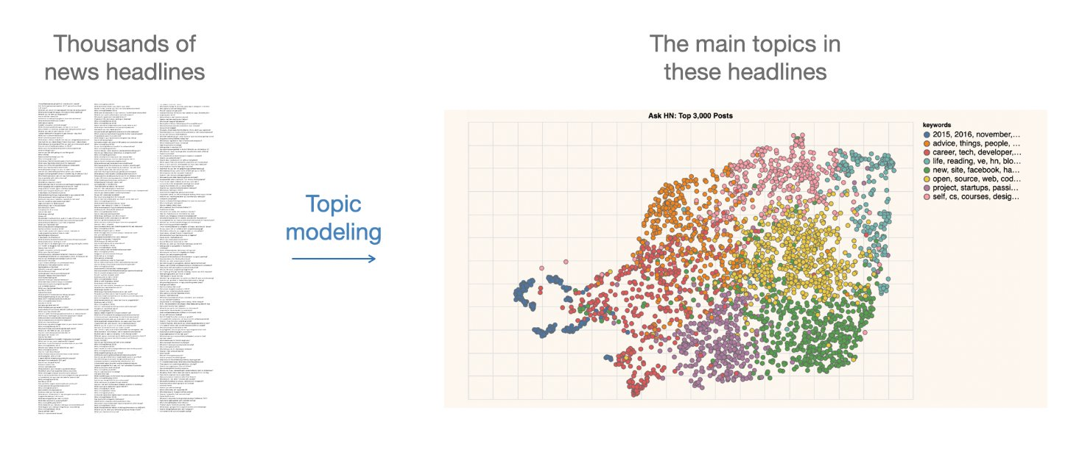
Definition
Topic
It is “a recurring pattern of co-occurring words” (Brett)
A topic can be defined as the main idea discussed in a text, i.e., the theme or subject of different granularity
Topics are simply groups of words from the collection of documents that represents the information in the collection in the best way
Topic Modeling
It is “a method for finding and tracing clusters of words (called topics) in large bodies of texts” (Brett)
It is a text mining approach to understand, organize, process, extract, manage, and summarize knowledge
Introduction
It performs soft clustering, where it presumes that every document is composed of a mixture of topics
It makes an excellent tool for discovery and helps to uncover evidence already present in the text
It has been called an act of reading tea leaves (Chang et al., 2009) or the process of highlighting words (Brett) based on their topics
It is based on statistical and machine learning techniques to mine meaningful information from a vast corpus of unstructured data and is used to mine document’s content
There are no machine-readable annotations that can tell the topic modeling programs about the semantic meaning of the words in the text
What Happens in Topic Modeling?

Slide 6
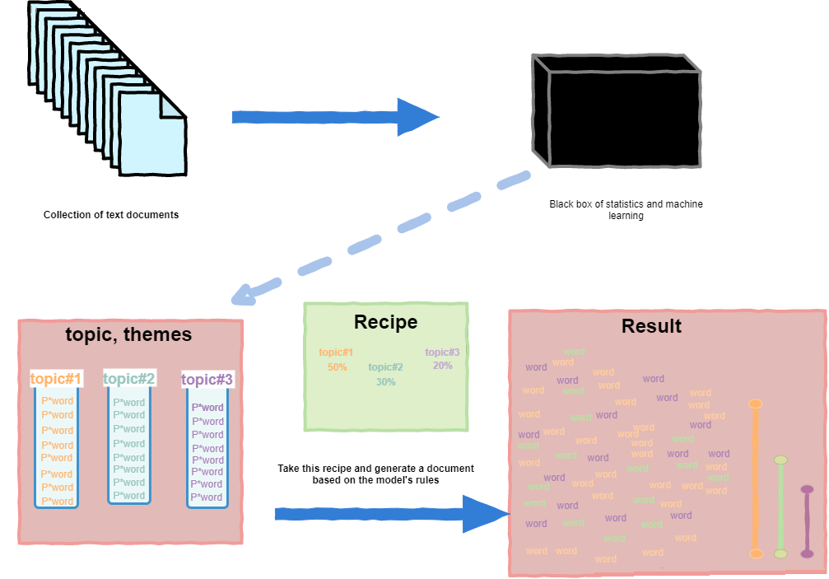
It infers abstract topics based on “similar patterns of word usage in each document”
These topics are simply groups of words from the collection of documents that represents the information in the collection in the best way
How Topic Modeling Works?

Slide 7
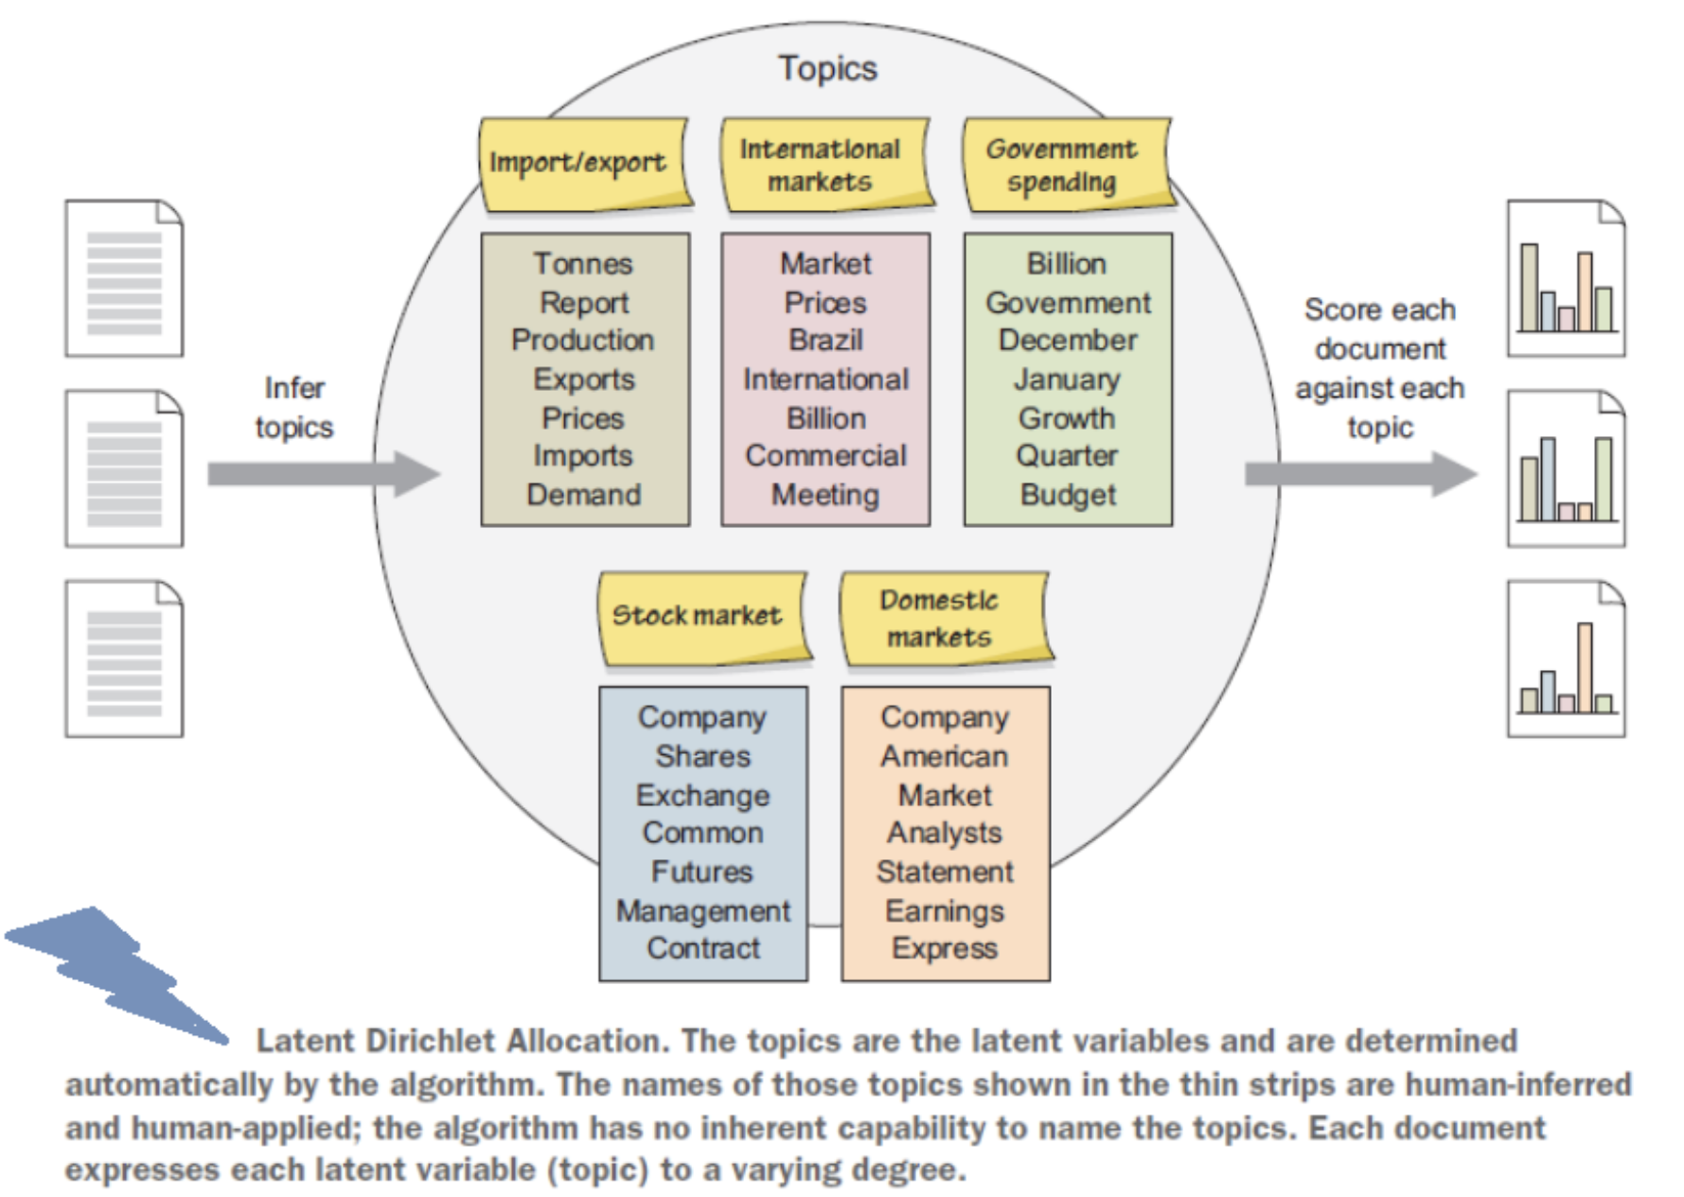
How Topic Modeling Works? (Cont.)

Slide 8
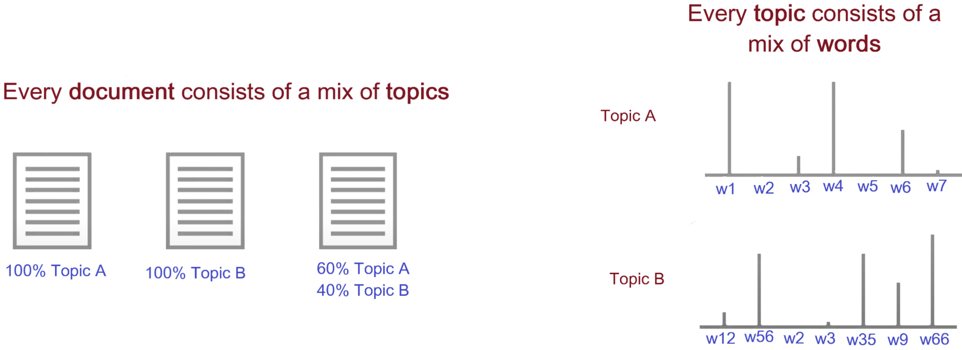
How Topic Modeling Works? (Cont.)

Slide 9
How to DO Topic Modeling?
Extract/Retrieve/Prepare dataset (e.g. webscraping, API, etc.)
Preparing a corpus (such as converting files from PDF to plain text format)
Conducting text pre-processing (removing, stopwords, tokenization, stemming, n-grams)
Exploratory analysis (Word clouds, clustering)
Determining the number of topics (using perplexity, coherence, entropy, or eye-ball method)
Selecting the appropriate algorithm (such as LDA, STM, CTM)
Seeding (so that one can reproduce the algorithm with the same selected parameters)
Running the selected algorithm using proprietary or open-source tools (such as RapidMiner, TopicModelingTool) or programming languages (such as R or Python)
Iterating the whole process till the algorithm fits the model
When to Use Topic Modeling
When you have a vast collection of text documents
When the collection belongs to a specific subject
When the collection has a similar type of documents, such as when all files in the collection are newspaper articles
When NOT to Use Topic Modeling
When you have a relatively small number of documents
When you do not have any idea about your collection. In this case, clustering will be a better option than using topic modeling
When the collection has a mixture of different types of documents, such as when the collection is composed of newspaper archives, journal articles, and ETDs
Available Tools and Packages

Slide 10
Out-of-Box Tools
Topic Modeling Tool
RapidMiner
VyontTools
DARIAH Topics Explorer
ORANGE
jsLDA ….. (more!)
R Libraries
quanteda
stm
tm
lda
topicmodels
text2vec
topicdoc
BTM
tidytext
textmineR …..(more!)

Slide 11
Topic Visualization
Open questions:
How we use the output of the algorithm?
How should we visualize and navigate the topical structure?
What do the topics and document representations tell us about the texts?
Output of topic modeling is not entirely human-readable, and one way to understand the results is through visualization
“Topic models are meant to help interpret and understand texts, but it is still the researcher’s job to do the actual interpreting and understanding” (Blei, 2012)
“But be sure that you can understand the visualization as topic modeling tools are fallible” (Blei, 2012)
Topic Visualization (Cont.)

Slide 12
Topics Evolve
Topic Analysis + Time
It assists in identifying topics within a context and how they advance in time
For instance, over time, few documents within a topic may initiate content that varies from the original content; If that initiated content is shared by a lot of later documents, the content is recognized as a new topic
Hence, with the progression of time, topics advance, new themes emerge, and old ones become obsolete
So, topic modeling not just helps the researchers to decide the trending topics or related fields to their field of intrigue but additionally encourages them to distinguish new concepts and fields over time

Slide 13
Application

Slide 14
Demo!

